Slide 1
RIFT: Major Developments – Strategies Moving Forward
Mid-Iowa Planned Giving Council
Tuesday, October 15, 2024
Bill Gustoff, JD
President of Legal Division
Thompson & Associates

Slide 2
RIFT Project
Release
IRA
Funds
Timely

Slide 3
RIFT Project
All volunteer
All pro bono

Slide 4
Key to Understanding
Custodians pay death claims either one of two ways:
Door #1 or Door #2

Slide 5
No Uniformity Among Custodians
It’s up to each custodian how they pay the claim
It’s a business practice
No consensus or uniformity
No uniformity among custodians

Slide 6
Key to Understanding: Door #1
Door #1 (the right way, IMHO)
After receiving basic info on the deceased and beneficiary, they pay the claim usually in 30 days

Slide 7
Custodians Request
Information to Pay the Claim
Name of deceased
Death certificate
Tax exempt status/articles of incorporation
Corporate resolution
W-9

Slide 8
Key to Understanding: Door #2
Door #2:
Some IRA custodians won’t
pay claims to “beneficiaries.”
They only pay if beneficiary (i.e., your charity) 1st becomes their new “customer.”

Slide 9
Door #2: Intense Procedures to Receive the IRA Death Proceeds
Door #2 financial institutions require the charity apply for and open up a new account first & then they transfer the donor’s IRA into it
Called an Inherited IRA (a.k.a., Beneficiary IRA)
In order to establish the new account, the Custodian interprets the charity as their “new customer”
That’s where things fall off the rails

Slide 10
How Do We Know Which Door?
They may never tell the charity; they just send 50 pages of forms to complete
“New Business” form
“New Owner” form
Tax ID number of control person or other employees or board members
Then charity has to liquidate this new account with a whole new set of forms
Delays, delays, delays

Slide 11
Who Does Not
Require an Inherited IRA
As of 9/1/2024:
Ameriprise
Bank of the West TD Ameritrade (but now see Schwab)
BNY Mellon/Pershing TIAA
Edward Jones UBS (mostly)
Merrill Lynch US Bank
Morgan Stanley* Vanguard*
Raymond James Wells Fargo Bank & Advisors
*Yet TOD’s require opening a new account

Slide 12
Who’ll Make an Exception?
As of 9/1/2024: KEY! Charities have to ask for the exception—it is not automatic. Use the RIFT letter made especially for this exception.
Charles Schwab – very easy to work with once you ask for the exception. If you don’t ask for it, they’ll make you open the Inherited IRA.
Equitable – Equitable will allow an exception if the charity pushes back against its requirements.

Slide 13
Most important!
No law requires a charity to open a new account
NO LAW REQUIRES DOOR #2
It’s the financial company’s business/compliance own choice/policy

Slide 14
Why?
“Asset Conservation” Technique
Used by Door #2 IRA Custodians
Stonewalls the payment to charities

Slide 15
Impact on Charities
Takes a minimum of 1-2 years to pay
Waited 6 years
Resent the paperwork 8 different times
Placed on phone “hold” by custodian for more than 8 hours straight
Happens with every single death claim every single time – no exceptions
Erroneously withholding taxes on IRAs

Slide 16
More Impacts on Charities
Never told it was beneficiary – 16 years passed
Received 10 cents
Fees to open account/close account
Custodian staff turnover
Custodian ‘loses’ paperwork
Only will talk with CFO
Have to send in paperwork within 60-day window with other charity beneficiaries

Slide 17
Why? Is it the Patriot Act?*
Enacted to prevent terrorism after 9/11
Is the charity a “known terrorist?”
Why won’t they use IRS Publication 78?
Legal Standard: “To form a reasonable belief that is knows the true identity of each customer”
* Know Your Customer, Customer Due Diligence, Customer Identification, Bank Secrecy, etc.

Slide 18
Does the Patriot Act* Really Apply?
The Financial Crimes Enforcement Network (FinCEN) is the government agency that regulates compliance with the Patriot Act:
“If the beneficiary continues to maintain the account after the passing of the previous customer, the bank should treat them as a customer.” -FinCEN’s Resource Center
6/20/2019

Slide 19
FinCEN
Reconfirmed in October 2022 with 7 of their lawyers
But stay tuned…more later…

Slide 20
Spring 2024 FinCEN
Broker-dealers still wanted SSN so RIFT met with FinCEN to clarify
RIFT Leaders Pled their case
FinCEN is worried charities could be funneling money to Hamas with death claims from IRAs

Slide 21
Spring 2024 FinCEN
Within a few days, on 3/1 FinCEN published this public Administrative Ruling: FIN-2024-R001
FinCEN said:
IF the donor account is with a “Broker-dealer” AND
IF Broker-dealer requires a new account (i.e., Door #2),
….then the charity HAS to give the SSN of its control person.
Issued pursuant to 31 CFR 1010.715

Slide 22
Spring 2024 FinCEN
What it didn’t say:
That an Inherited IRA/2nd account (Door #2) is required by FinCEN to pay a death claim.

Slide 23
Assess the Risk
Charities - “low” risk for money laundering and terrorist activity
Regulated into absurdity – it would be funny if it wasn’t so serious – gov’t regulations run amok
Beyond common sense!

Slide 24
Strategies to Push Back
State laws
Federal law to prevent this
Judicial – class action litigation
FinCEN-U.S. Treasury exception request
Nationwide advisory group

Slide 25
Strategies to Push Back
State laws
Federal law to prevent this
Judicial – class action litigation
FinCEN-U.S. Treasury exception request
Nationwide advisory group

Slide 26
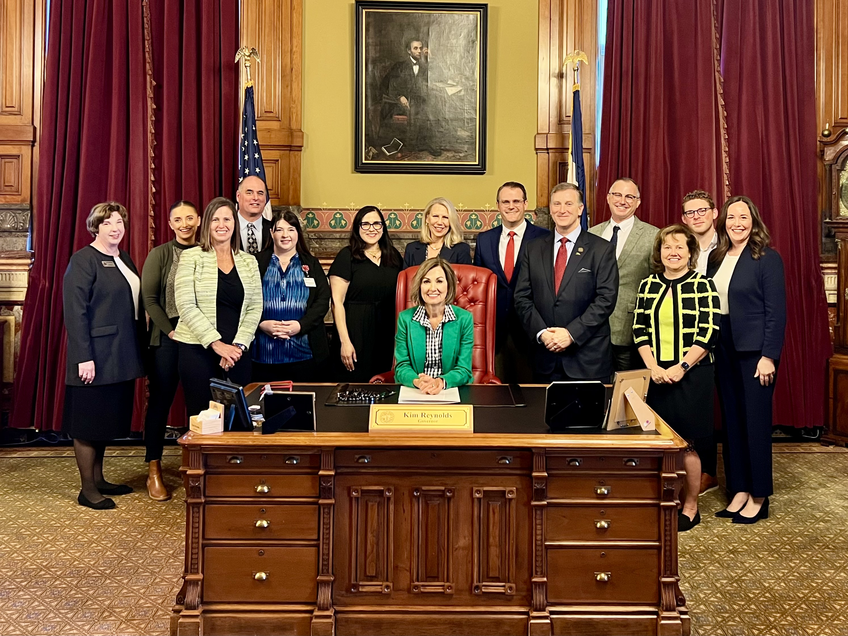
Iowa Leads the Way!
The Journey to May 3, 2024
Iowa HF 2366

Slide 27
House File 2366
Effective 7-1-2024
Which nonprofits are protected?
Iowa charitiesi

Slide 28
HF 2366 Provisions
Beneficiary Designations
Annuity
Insurance policy
POD account
TOD account
Pension, profit sharing, retirement other other employment-related benefit plans
Any other non-probate transfer at death
Note -- not from a will or trust

Slide 29
HF 2366 Provisions
When a charity is a beneficiary, it can give an affidavit to the financial company holding the account.
The affidavit shall state all of the following……….

Slide 30
Affidavit
The decedent’s name and last known address
A general description of the property to the extent known
The charity’s name, address and primary contact info
The charity is a charitable organization as defined in Iowa Code 15E.311
A request that the property be paid or transferred to the charity OR that the information about the property be given to the charity (e.g., amount of death benefit)
No one else other than the charity has a right to the interest in the property listed in the affidavit
The information provided is true and correct
Signed by a duly authorized representative of the charity under penalty of perjury before a notary public

Slide 31
HF 2366 Provisions
Accompany the affidavit with all the following:
Federal IRS determination letter
Iowa Secretary of State Certificate of Existence
A statement that the account owner is deceased supported by
Death certificate,
Probate notice in paper, Receipt of paid funeral expenses, or
Obituary
A corporate resolution or similar statement of the affiant to show he or she can act on behalf of the charity
IRS form W-9

Slide 32
HF 2366 Provisions
The financial institution shall not ask for any other personal information from any employee or board member of the charity.
The financial institution specifically cannot ask for:
Social Security Number
Driver’s license number
Contact information
Personal financial information

Slide 33
HF 2366 Provisions
Financial company shall pay, deliver or transfer to the charity, OR
Deliver the information -- if information was requested (e.g., amount of the death claim).
The time the financial institution can take to verify the charity’s information is 30 days from the date of delivery of the affidavit (note send it certified mail, return receipt requested so you can document the start of the 30-day window)

Slide 34
What if the Financial Institution Fails to Respond?
If the financial institution refuses to pay the claim or provide the information requested within 30 days of receiving the affidavit, the charity can bring an action against the financial institution to get paid or get the information requested.
The court action must be brought within one year after the date of the act or failure to act.

Slide 35
Charity’s Legal Remedies
If the court finds the financial institution acted unreasonably in failing to pay or provide the information, the court may award the charity any or all of these:
1. Damages the charity sustained
2. Costs of the legal action
3. A penalty between $500 and $10,000
4. Reasonable attorney fees

Slide 36
Not one single vote against this law in any of the 6 House and Senate votes!

Slide 37
Can this Iowa Law be shared with other states?

Slide 38
Introducing the Model Law:
CHARITABLE ORGANIZATIONS PRIVACY PROTECTION ACT

Slide 39
How does Iowa HF 2366 interact
with the 2024 FinCEN ruling?

Slide 40
What Now?
What we still don’t know and needs researched:
1) What is the weight of authority of this FinCEN ruling. Is it considered “federal law?”
2) Does it trump the Iowa law or not?
If it trumps, SSN may still be required for Iowa charities with broker-dealer accounts using door #2

Slide 41
Other State Efforts
Every state attorney general oversees the performance of charitable trusts and their fiduciaries.
The state attorney general is charged with protecting consumers from unfair trade practices.
Met with North Carolina Attorney General Josh Stein’s office to explain the issue of charities being forced to become customers of a financial institution.
NC Attorney General is looking into this.

Slide 42
More State Efforts
Presentation made to the Tennessee Attorney General’s Office in August 2023

Slide 43
Strategies to Push Back
State Laws/Attorneys General
Federal Law
Judicial – Class action litigation
FinCEN/US Treasury exception request
Nationwide advisory group

Slide 44
Federal Law Efforts
Working on finding a US Senator/Congressman champion to bring federal legislation stopping financial institutions from these predatory practices
Lobbyist

Slide 45
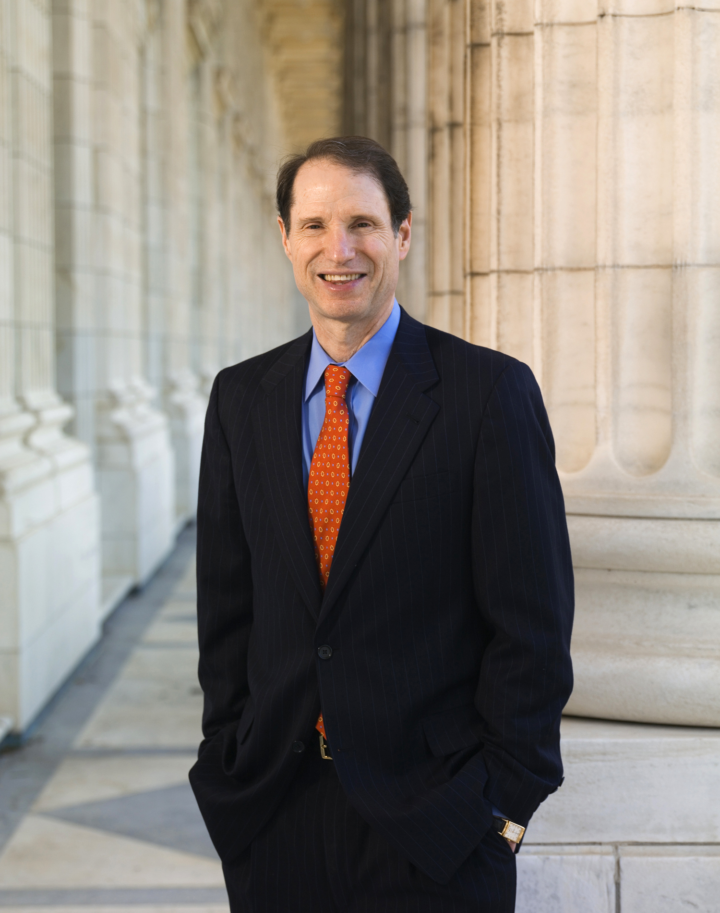
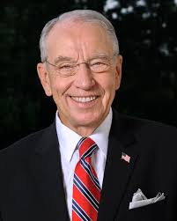
Contact Senator Wyden
Chair of Senate Finance
Committee
Ron Wyden (OR)
Democrat
P: (202) 224-5244 F: (202) 228-2717

Slide 46
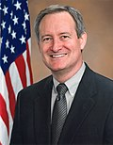
Contact Senator Crapo
Senator Mike Crapo (ID)
Republican
Ranking Member
Senate Finance
Committee
Phone: (202) 224-6142
Fax: (202) 228-1375
This Photo by Unknown Author is licensed under CC BY-SA

Slide 47
Contact Jamie Cummins
Jamie Cummins
Senior Tax Counsel
Senate Finance Committee
Email: Jamie_Cummins@finance.senate.gov
Charities need to share how hard this is on them.

Slide 48
Contact
Contact Senator Tim Scott (South Carolina)
P: (202) 224-6121
Contact Senator Jerry Moran (Kansas)
P: (202) 224-6521

Slide 49
Strategies to Push Back
State Laws/Attorneys General
Federal Law
Judicial – Class action litigation
FinCEN/U.S. Treasury exception request
Nationwide advisory group

Slide 50
Strategies to Push Back
State Laws/Attorneys General
Federal Law
Judicial – Class action litigation
FinCEN/U.S. Treasury exception request
Nationwide advisory group

Slide 51
CONTACT FinCEN
www.fincen.gov/contact
Email to FRC@fincen.gov
Leave message @ 703-905-3591 hotline
Andrea Gacki, Director
Ms. Gacki – needs to hear how hard this is on charities
Charities need an exception carved out to this ruling

Slide 52
Strategies to Push Back
State Laws/Attorneys General
Federal Law
Judicial – Class action litigation
FinCEN/U.S. Treasury exception request
Nationwide advisory groups
RIFT Advocates
General Counsels

Slide 53
Get Support
“RIFT Advocates”
Bequest Working Group
For charities to participate, contact:
Karen Smedley – Duke University
Phone: 919-684-0367

Slide 54
Strategies to Push Back
State Laws/Attorneys General
Federal Law
Judicial – Class action litigation
FinCEN/U.S. Treasury exception request
Nationwide advisory groups
RIFT Advocates
General Counsels

Slide 55
General Counsel Advisory Group
“RIFT” General Counsel Advisory Group
To participate, contact:
Johni Hays, JD – Thompson & Associates
Phone: 515-988-8817
johni@ceplan.com

Slide 56
Want to Get Involved?
RIFT Advocates – Contact Karen Smedley, 919-684-0367
General Involvement – Johni Hays, 515-988-8817 or johni@ceplan.com

Slide 57
Questions?
Bill Gustoff
bill@ceplan.com
515-201-3867

